Slide 1
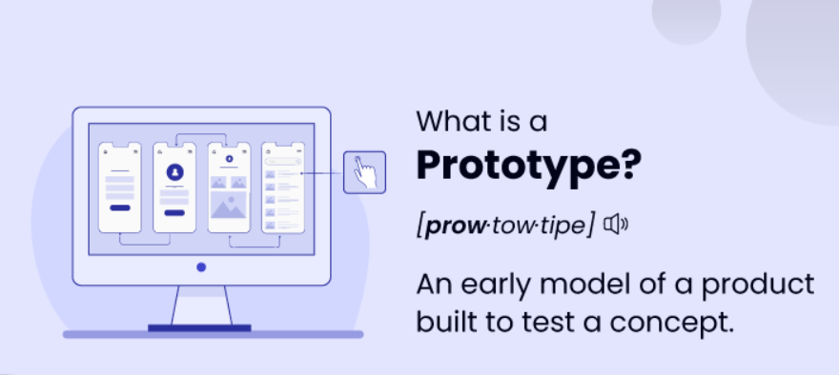

Slide 2
Need for this Prototype
Long coffee shop lines: Tired of waiting in line for your morning coffee? Our prototype streamlines ordering and payment, letting you grab your caffeine fix faster.
• Hectic scientist's schedule: Scientists juggle experiments, meetings, and deadlines. Our prototype allows them to order lab supplies or equipment efficiently, saving precious time.
• Missed opportunities: Don't lose customers due to long queues. Our prototype keeps lines moving, improving customer experience and satisfaction.
• Wasted lunch breaks: Employees shouldn't spend their breaks waiting in line for food. Our solution lets them order and pay quickly, maximizing their break time.
• Frustration and impatience: Queues create frustration and impatience. Our prototype reduces wait times, leading to a calmer and more pleasant experience.

Slide 3
• Staff inefficiency: Cashiers and servers spend time managing long lines. Our prototype frees them up to focus on customer service and other tasks.
• Inventory management: Real-time data from our prototype helps businesses optimize inventory levels and avoid stockouts.
• Scalability: Our solution adapts to varying customer traffic, ensuring smooth operation during peak hours.
• Accessibility: Our prototype caters to users with disabilities, making queues more inclusive.
• Data insights: Gain valuable data on customer behavior and preferences, allowing for better decision-making and improved service.

Slide 4
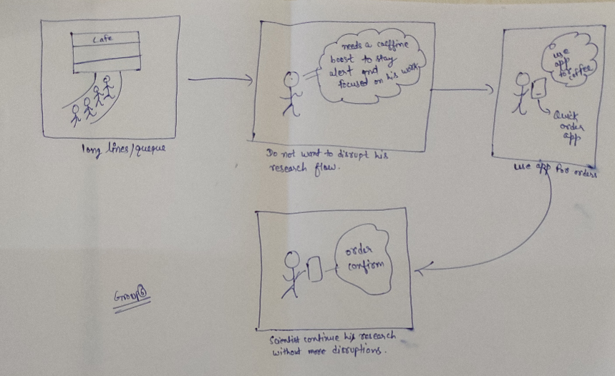
Prototype 1

Slide 5
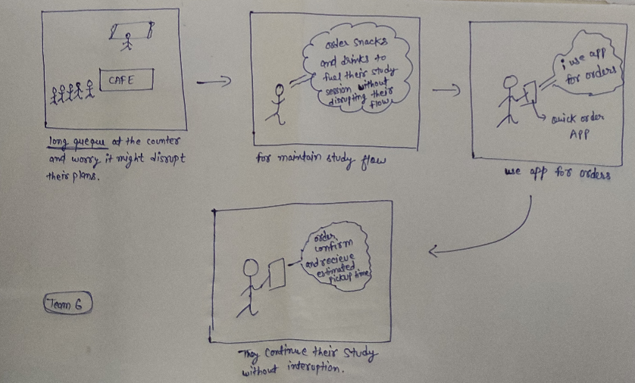
Prototype 2

Slide 6
Thank You
Team 6 Design Thinking

